Slide 1
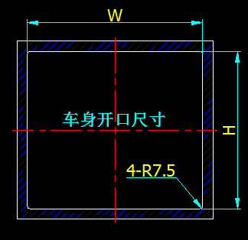
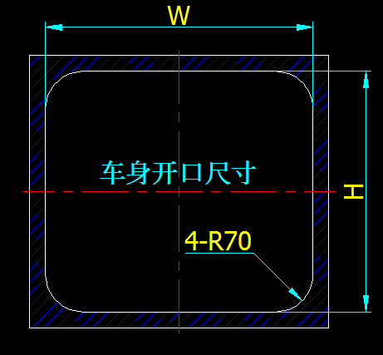
RV WINDOW（SX-R70/SX-R7.5） INSTALLTION
一、车身墙板开口
一、car body cut hole
Cut hole size（same as order size） ：WxHx4-R7.5
Cut hole size（same as order size） ：WxHx4-R70
ANHUI SHENG XUAN RV ACCESSORIES CO., LTD.

Slide 2
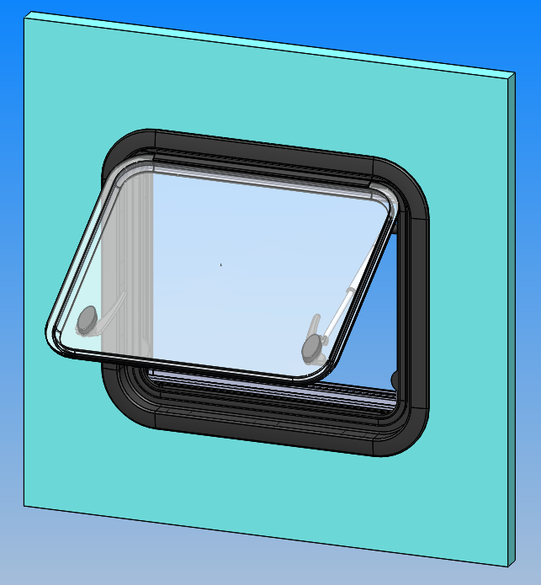
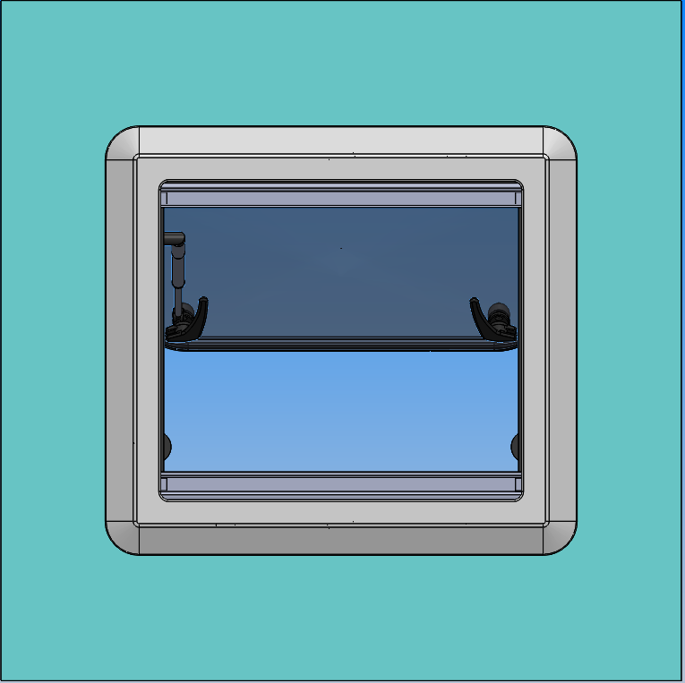
二、Installation positioning of components
RV PANEL
Window Glass
screen
hinged
support rod
lock
Rubble seal strip
Outer frame
Outer of RV
Inner for RV
ANHUI SHENG XUAN RV ACCESSORIES CO., LTD.

Slide 3
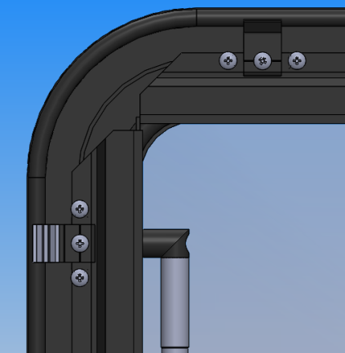
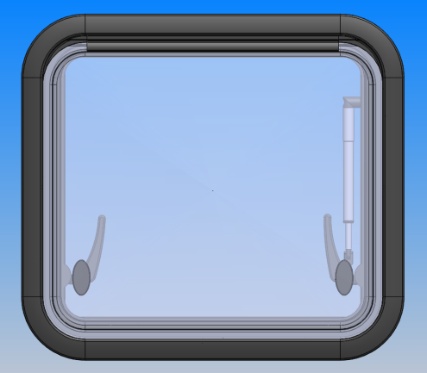
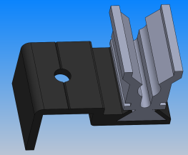
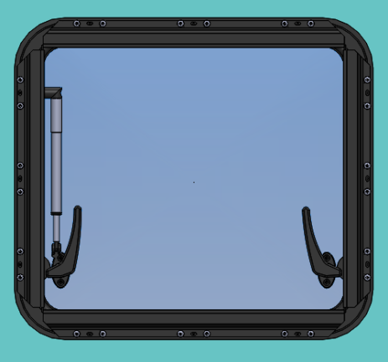
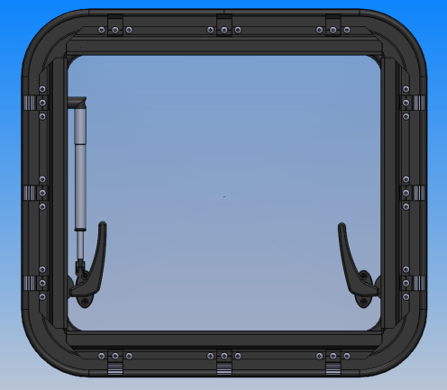
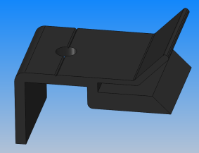
三、Installation positioning of glass window
If the wall panel is not smooth, please apply fixed adhesive to the surrounding section of the opening, so as to effectively strengthen the waterproof performance of the window
Glass window
Cut hole panel
The hinge is fixed by tapping screw to determine the position
Pic. 1
Pic. 2
RV insider
Pic. 3
Fixed parts
Pic. 4
Place the Windows in Pic. 1 on the wallboard equally with the top, bottom, left and right side of the opening area
Put the Pic.3 fixed parts in the outer frame of the Pic.4 glass window, and corresponding to the fixing screw holes in the outer frame of glass window
ANHUI SHENG XUAN RV ACCESSORIES CO., LTD.

Slide 4
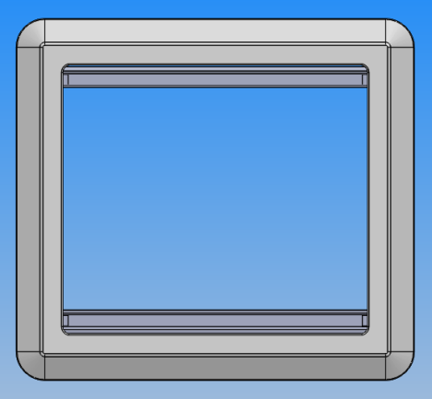
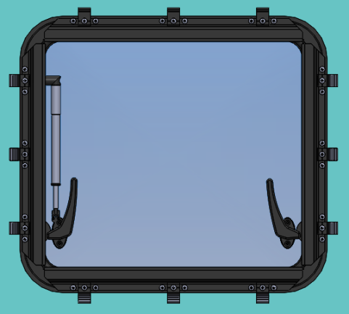
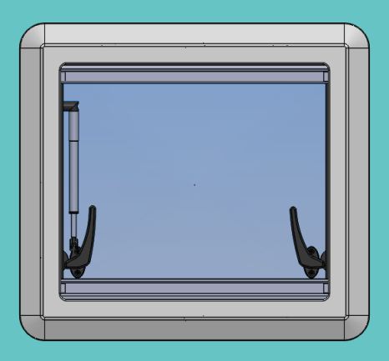
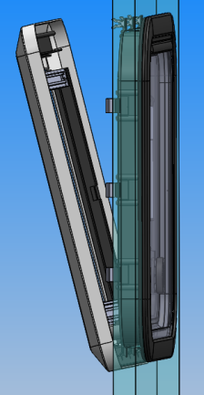
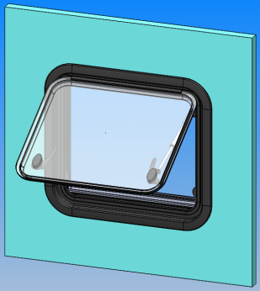
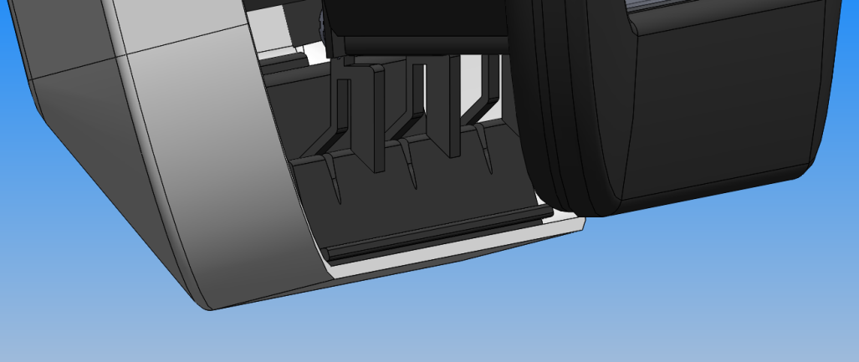
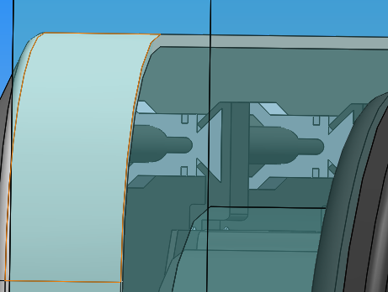
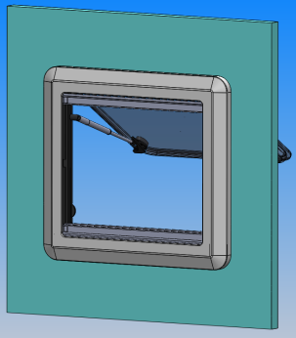
七、Installation positioning of screen window
Pu pic.a screen window on the wallboard pic.b equally with the top, bottom, left and right side of the cut hole area
Put the screen window pic.a at a certain angle from the wall panel
Screen window
RV inside
··
··
··
RV outside
Pic.a
Pic.b
Press the down, left and right of screen window pic.a against the fixed parts slightly to make it stick in the place
Complete the installation
After determining the position, hang the drop down with the screen window as shown in the picture and down side alignment with fixed parts left and right
RV inside
ANHUI SHENG XUAN RV ACCESSORIES CO., LTD.

